Slide 1
Move over Bootstrap and Foundation Welcome Semantic UI
Notes:
Hello everyone,
I am Jinhao Ping. Here is my presentation topic …
Today, I am going to introduce you three popular front-end frameworks
I will talk about their advantages and disadvantages. And my opinion on how to choose the right front-end framwork for yourself.

Slide 2

Mobile First Design
Notes:
Nowadays, if you still think in your mind that mobile web design and application development is a very niche industry, you are out of date.
Mobile is not the trend, nor is it even the future, it is the present.
According to statistics on Mobithinking, there are over 1.2 billion mobile web users worldwide. In the United States, 25% of mobile web users are mobile-only which means they rarely use a desktop to access the web. [1] So mobile-friendly, responsive websites are not something good-to-haves. Instead, they are must-haves.

Slide 3
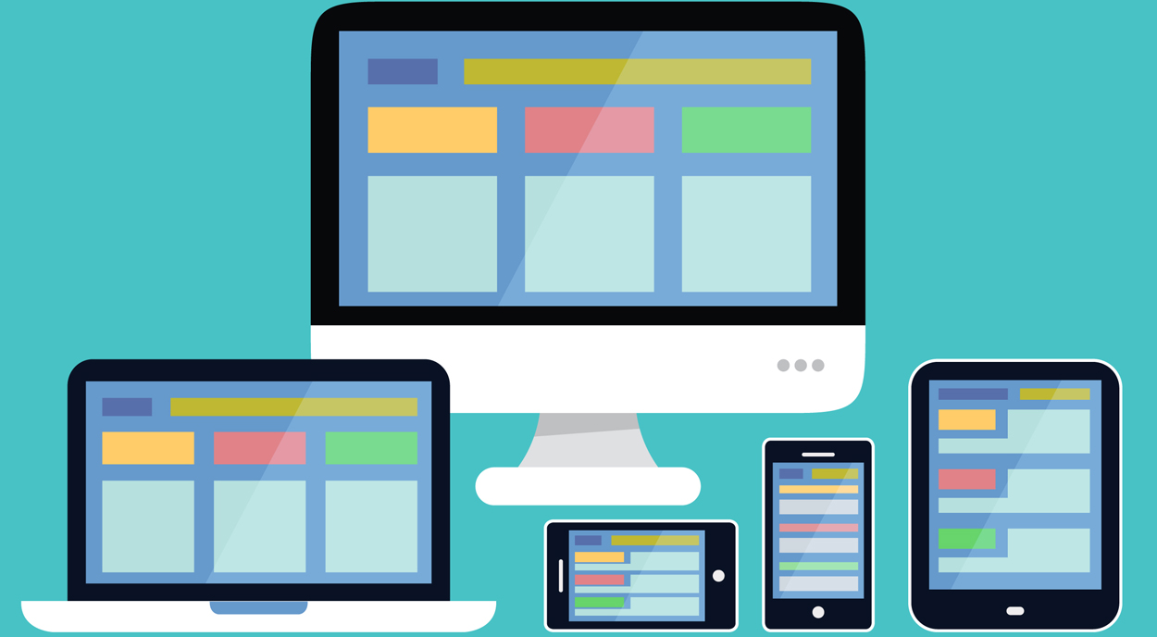
Responsive Web Design
Notes:
responsive web design is a relatively new approach to website design that ensures users have a good viewing experience no matter what type of device they are using. [3] If your site is not responsive and optimized for mobile browsing, your bounce rates will rise and your site ranking will drop
if your site is not designed to be responsive, you will have to retrofit it, which costs you extra time and money. Here we comes with the Bootstrap framework which is an excellent choice for building a responsive mobile website or application from scratch.

Slide 4
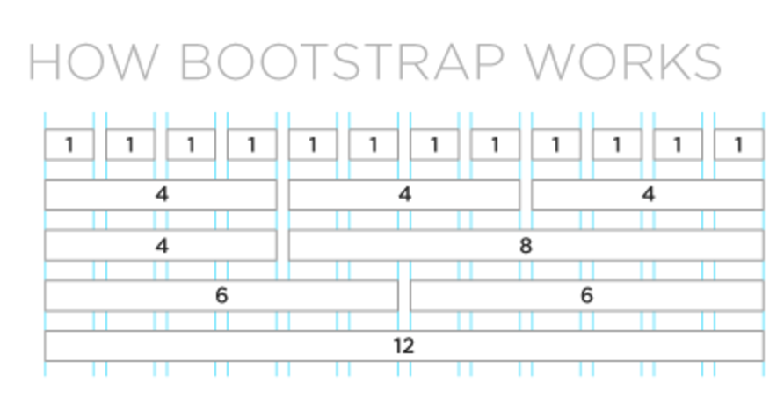
Bootstrap
Notes:
Bootstrap is a front-end framework that builds responsive, mobile-first websites, developed by Mark Otto and Jacob Thornton at Twitter and released as an open source product in August 2011 on Github.
In Bootstrap, content are divided into a maximum of 12 columns and then condensed down to 6, 4, 3 or less depending on the device viewing the site. In order to achieve responsive design, the app will detect the pixel size of the user’s device and then adjust the columns accordingly. The following is a straightforward graph showing you how Bootstrap works.

Slide 5
Advantages:
Easy to use, basic HTML and CSS knowledge
Fast Speed of Development
Responsiveness
Compatible with all modern browsers

Slide 6
Disadvantages:
Bloated, files generated are large
Constantly under development, updates may be difficult to integrate
Sites start looking the same, think about Wordpress

Slide 7
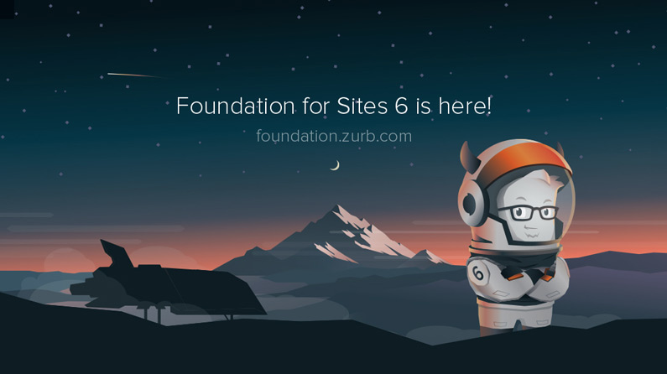
Foundation
Notes:
Foundation, a responsive front-end framework built by a product design company named Zurb, is open source and was released in 2011 under the MIT license. It is quite similar with Bootstrap in many ways such that it can be used for building a responsive website and it is compatible with many browsers.

Slide 8
Advantages:
Completely semantic markup
No extra IDs, classes or non-semantic empty HTML
Good for maintainability and reusability
Responsiveness
Sass more powerful than Less
Less does not have as many awesome frameworks as Compass.
Notes:
First of all, Foundation can be used with completely semantic markup. Since Foundation is built with Compass, it would allow the abstraction of presentation to be easier and faster. There is no need for extraneous IDs, classes or non-semantic empty HTML elements. This way is better in maintainability and reusability. Also Foundation’s code looks much more straightforward than Bootstrap.
Foundation uses Sass, the finest CSS pre-processor. It makes for a more modular, pragmatic approach to presentation. Sass is a lot more powerful than Less of Bootstrap. Less does have some extensions. However, Less does not have as many awesome frameworks like Compass.

Slide 9
Disadvantages:
Fewer selection of themes
Do not support for IE8
Community size

Slide 10
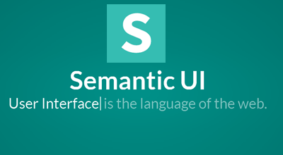
Semantic UI
Notes:
Semantic is a development framework that helps create beautiful, responsive layouts using human-friendly HTML.
Semantic empowers designers and developers by creating a shared vocabulary for UI.
Semantic UI is a new player on the field of HTML/CSS frameworks, but it is coming in strong.

Slide 11
Advantages:
Designed completely with EM
Everything is defined using em and rem
Components could be resized simply on the fly
Easy to learn
Uses simply and natural languages for describing elements
Codes are shorter
High-level theming with 3000+ theming variables
Gives you complete design freedom
Notes:
First of all, Semantic is designed completely with EM. Everything is defined using em and rem in this way that components could be resized simply on the fly. All you need to do is to change using a media query.
uses simply, common and natural languages for describing elements.
Code is shorter in lines compared to Bootstrap
All UI components share site-wide defaults. This lets you change the look and feel of components quickly and gives you complete design freedom.

Slide 12
Disadvantages:
Not want to use it for large projects
All features will not work without writing JavaScript scripts
Notes:
Semantic UI is pretty new and still under development. People may not want to use it for large projects, which depend on huge resources and support from community.
Furthermore, JavaScript is an essential skill to develop website interfaces using Semantic UI. Almost all features will not work without writing JavaScript scripts such as modal window and dropdown.

Slide 13
Summary
Bootstrap is better for beginners to start with. It has a large supporting community to discuss problems
Foundation is very good for mobile-first development. Codes look more straightforward
Semantic UI looks more modern and contains much more themes than the others

Slide 14
Conclusion
Speed and Stability: Bootstrap
Flexibility: Foundation
Junior front-end developer: Bootstrap
Experienced developer: Semantic UI

Slide 15
Additional Information:
Twitter Bootstrap vs. Semantic UIhttps://www.upwork.com/hiring/development/twitter-bootstrap-vs-semantic-ui/
Top 10 reasons to use Zurb’s Foundation frameworkhttp://www.zingdesign.com/top-10-reasons-to-use-zurbs-foundation-framework/
Mobile First Design: Why It’s Great and Why It Sucks
https://codemyviews.com/blog/mobilefirst

